Slide 1
Data Structures
12. Queues

Slide 2
Queues
Queue is First-In-First-Out (FIFO) data structure
First element added to the queue will be first one to be removed
Queue implements a special kind of list
Items are inserted at one end (the rear)
Items are deleted at the other end (the front)

Slide 3

Queue – Analogy (1)
A queue is like a line of people waiting for a bank teller
The queue has a front and a rear
Rear
Front

Slide 4
Queue – Analogy (2)
New people must enter the queue at the rear
Front
Rear

Slide 5
Queue – Analogy (3)
An item is always taken from the front of the queue
Rear
Front

Slide 6
Queues – Examples
Billing counter
Booking movie tickets
Queue for paying bills
A print queue
Vehicles on toll-tax bridge
Luggage checking machine
And others?

Slide 7
Queues – Applications
Operating systems
Process scheduling in multiprogramming environment
Controlling provisioning of resources to multiple users (or processing)
Middleware/Communication software
Hold messages/packets in order of their arrival
Messages are usually transmitted faster than the time to process them
The most common application is in client-server models
Multiple clients may be requesting services from one or more servers
Some clients may have to wait while the servers are busy
Those clients are placed in a queue and serviced in the order of arrival

Slide 8
Basic Operations (Queue ADT)
MAKENULL(Q)
Makes Queue Q be an empty list
FRONT(Q)
Returns the first element on Queue Q
ENQUEUE(x,Q)
Inserts element x at the end of Queue Q
DEQUEUE(Q)
Deletes the first element of Q
EMPTY(Q)
Returns true if and only if Q is an empty queue

Slide 9
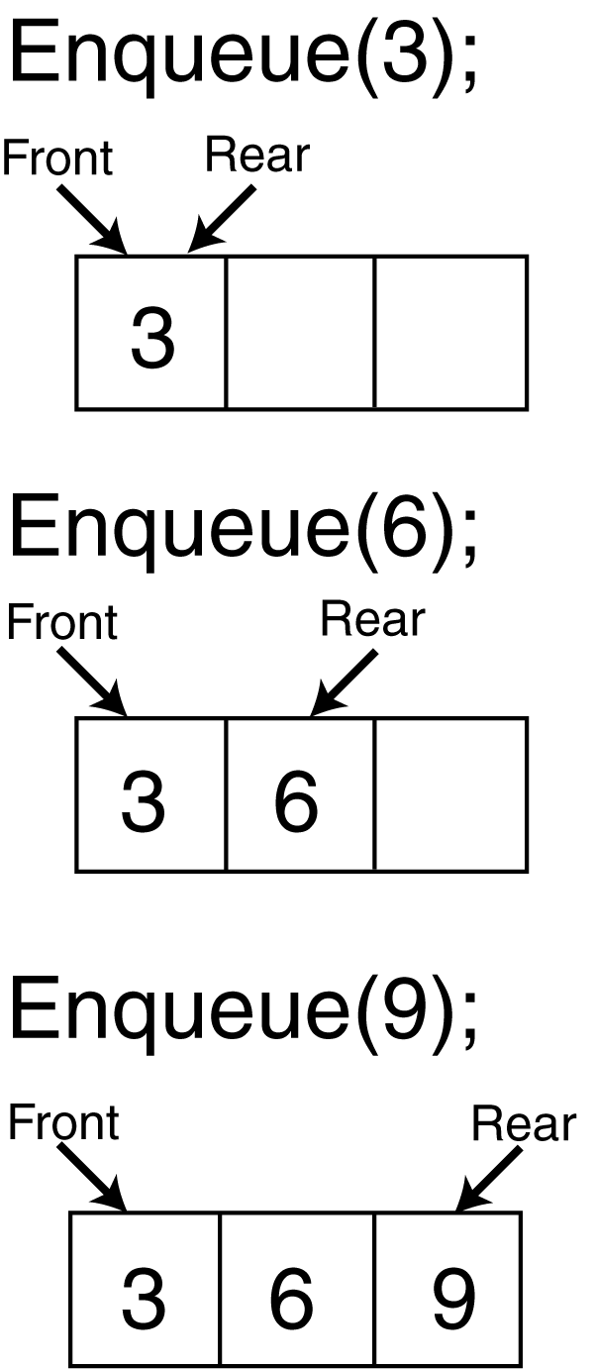
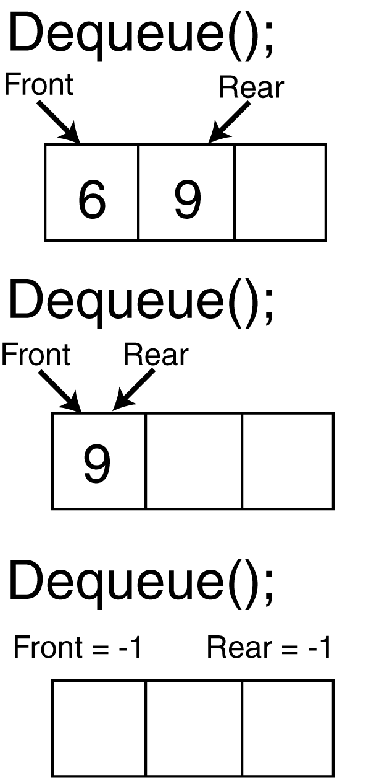
Enqueue And Dequeue Operations

Slide 10
Implementation
Static
Queue is implemented by an array
Size of queue remains fix
Dynamic
A queue can be implemented as a linked list
Expand or shrink with each enqueue or dequeue operation

Slide 11
Array Implementation
Use two counters that signify rear and front
When queue is empty
Both front and rear are set to -1
When there is only one value in the Queue,
Both rear and front have same index
While enqueueing increment rear by 1
While dequeueing, increment front by 1
front
A
B
C
D
EF
G
First Element
Second Element
.
.
.
rear
Last Element

Slide 12
Array Implementation Example (1)
front= -1
rear = -1
0 1 2 3 4 5 6 7 8
5
front= 0
rear = 0
0 1 2 3 4 5 6 7 8
5
4
front= 0
rear = 1
0 1 2 3 4 5 6 7 8

Slide 13
Array Implementation Example (2)
5
4
6
7
8
7
6
front=0
rear=6
0 1 2 3 4 5 6 7 8
8
7
6
front=4
rear=6
0 1 2 3 4 5 6 7 8
7
6
12
67
front=5
rear=8
0 1 2 3 4 5 6 7 8
Problem: How can we insert more elements?
Rear index can not move beyond the last element….

Slide 14
Using Circular Queue
Allow rear to wrap around the array
if(rear == queueSize-1)
rear = 0;
else
rear++;
Alternatively, use modular arithmetic
rear = (rear + 1) % queueSize;

Slide 15
Example
7
6
12
67
front=5
rear=8
0 1 2 3 4 5 6 7 8
Enqueue 39
Rear = (Rear+1) mod queueSize = (8+1) mod 9 = 0
39
7
6
12
67
front=5
rear=0
0 1 2 3 4 5 6 7 8
Problem: How to avoid overwriting an existing element?

Slide 16
How to Determine Empty and Full Queues?
A counter indicating number of values/items in the queue
Covered in first array-based implementation
Without using an additional counter (only relying on front and rear)
Covered in alternative array-based implementation

Slide 17
Array-based Implementation

Slide 18
Array Implementation – Code (1)
class IntQueue { private: int *queueArray; // Pointer to array implemented as Queue int queueSize; // Total size of the Queue int front; int rear; int numItems; // Number of items currently in the Queue
public: IntQueue(int); ~IntQueue(void); void enqueue(int); int dequeue(void); bool isEmpty(void); bool isFull(void); void makeNull(void);
};

Slide 19
Array Implementation – Code (2)
class IntQueue { private: int *queueArray; // Pointer to array implemented as Queue int queueSize; // Total size of the Queue int front; int rear; int numItems; // Number of items currently in the Queue
public: IntQueue(int); ~IntQueue(void); void enqueue(int); int dequeue(void); bool isEmpty(void); bool isFull(void); void makeNull(void);
};
Clears the queue by resetting the front and rear indices, and setting the numItems to 0.

Slide 20
Array Implementation – Code (3)
Constructor
IntQueue::IntQueue(int s) //constructor
{
queueArray = new int[s]; queueSize = s; front = -1; rear = -1; numItems = 0; }
Destructor
IntQueue::~IntQueue(void) //destructor
{ delete [] queueArray;
}

Slide 21
Array Implementation – Code (4)
isFull() returns true if the queue is full and false otherwise
bool IntQueue::isFull(void) { if (numItems < queueSize) return false; else return true; }
isEmpty() returns true if the queue is empty and false otherwise
bool IntQueue::isEmpty(void) { if (numItems == 0) return true; else return false; }

Slide 22
Array Implementation – Code (5)
makeNull() resets front & rear indices and sets numItems= 0
void IntQueue::makeNull(void) { front = - 1; rear = - 1; numItems = 0; }

Slide 23
Array Implementation – Code (6)
Function enqueue inserts the value in num at the end of the Queue
void IntQueue::enqueue(int num) {
if (isFull()) cout << "The queue is full.\n";
else {
// Calculate the new rear position
rear = (rear + 1) % queueSize;
// Insert new item
queueArray[rear] = num;
// Update item count
numItems++;
}
}

Slide 24
Array Implementation – Code (7)
Function dequeue removes and returns the value at the front of the Queue
int IntQueue::dequeue(void)
{
int num;
if (isEmpty())
cout << "The queue is empty.\n";
else {
// Move front
front = (front + 1) % queueSize;
// Retrieve the front item
num = queueArray[front];
// Update item count
numItems--;
}
return num;
}

Slide 25
Using Queues
Output:
Enqueuing 5 items... Now attempting to enqueue again... The queue is full The values in the queue were: 0
1
2
3
4
void main(void)
{
IntQueue iQueue(5);
cout << "Enqueuing 5 items...\n";
// Enqueue 5 items.
for (int x = 0; x < 5; x++)
iQueue.enqueue(x);
// Attempt to enqueue a 6th item.
cout << "Now attempting to enqueue again...\n";
iQueue.enqueue(5);
// Deqeue and retrieve all items in the queue
cout << "The values in the queue were:\n";
while (!iQueue.isEmpty()){
int value;
value = iQueue.dequeue();
cout << value << endl;
}
}

Slide 26
Alternative Array-based Implementation

Slide 27
Alternative Implementation – Code (1)
class CQueue
{
Private:
int *queueArray; // Pointer to array implemented as Queue
int queueSize; // Total size of the Queue
int front;
int rear;
public:
CQueue(int size);
~CQueue( );
bool IsFull();
bool IsEmpty();
void enqueue(int num);
int dequeue();
void MakeNull();
};

Slide 28
Alternative Implementation – Code (2)
isEmpty() returns true if the queue is empty and false otherwise
bool CQueue::IsEmpty()
{
if (front==-1)
return true; // we can check “rear” too
else
return false;
}
isFull() returns true if the queue is full and false otherwise
bool CQueue::IsFull()
{
if ( ( (rear+1)%queueSize ) == front )
return true;
else
return false;
}

Slide 29
Alternative Implementation – Code (3)
Function enqueue inserts the value in num at the end of the Queue
void CQueue ::enqueue(int num);
{
if ( IsFull() ) {
cout<<“Overflow”;
return;
}
if (IsEmpty())
rear = front = 0;
else
rear=(rear+1) % queueSize;
queueArray[rear] = num;
}

Slide 30
Comparison: enqueue Operation
void CQueue ::enqueue(int num);
{
if ( IsFull() ) {
cout<<“Overflow”;
return;
}
if (IsEmpty())
rear = front = 0;
else
rear=(rear+1) % queueSize;
queueArray[rear] = num;
}
void IntQueue::enqueue(int num) {
if (isFull()) cout << "The queue is full.\n";
else {
// Calculate the new rear position
rear = (rear + 1) % queueSize;
// Insert new item
queueArray[rear] = num;
// Update item count
numItems++;
}
}

Slide 31
Alternative Implementation – Code (4)
Function dequeue removes and returns the value at the front of the Queue
int CQueue::dequeue()
{
if ( IsEmpty() ) {
cout<<“Underflow”;
return;
}
int ReturnValue = queueArray[front];
if ( front == rear ) //only one element in the queue
front = rear = -1;
else
front = (front+1) % queueSize;
return ReturnValue;
}

Slide 32

Any Question So Far?

